Slide 1
collective intelligence - Formation
Ákos Rúzsa
fr2wt6@inf.elte.hu

Slide 2
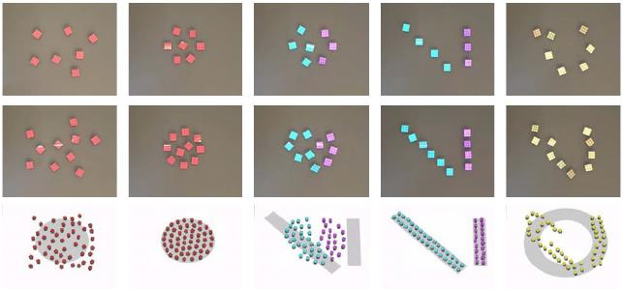
Formation
Create a multi-agent system in which the agents learn to form a predefined shape. No agent should be outside this shape, and inside they should be uniformly distributed.
The agents will first form a simple shape (circle) then move to a different, more complex shape.

Slide 3
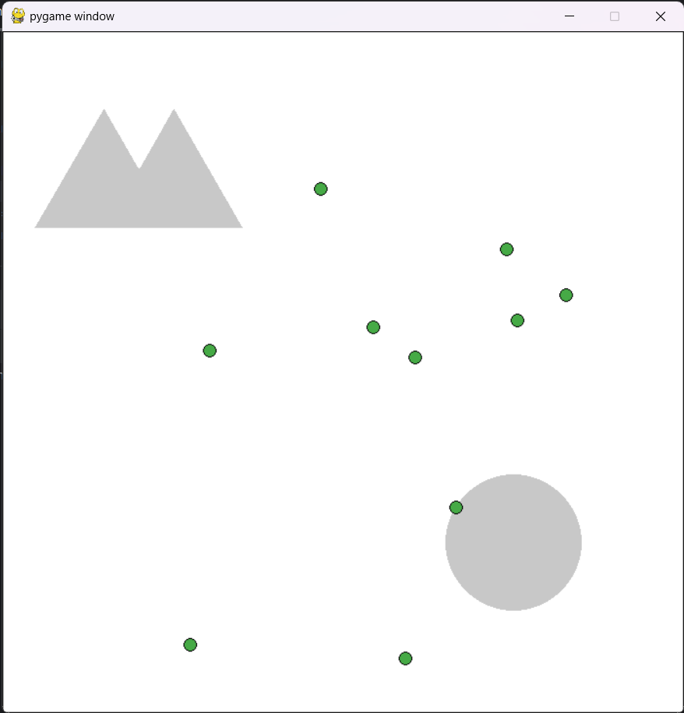
Environment
Modification of the PettingZoo SimpleTag environment
Only a single agent type
No obstacles
Added two shapes, the circle and the “mountains”
Image(s)

Slide 4
Observation spaces
Consists of 4 values:
Relative position to the center of the object on the x axis
Relative position to the center of the object on the y axis
Relative position to the closest other agent on the x axis
Relative position to the closest other agent on the y axis

Slide 5
Action spaces
Very simple, 5 actions:
Stay
Up
Down
Left
Right

Slide 6
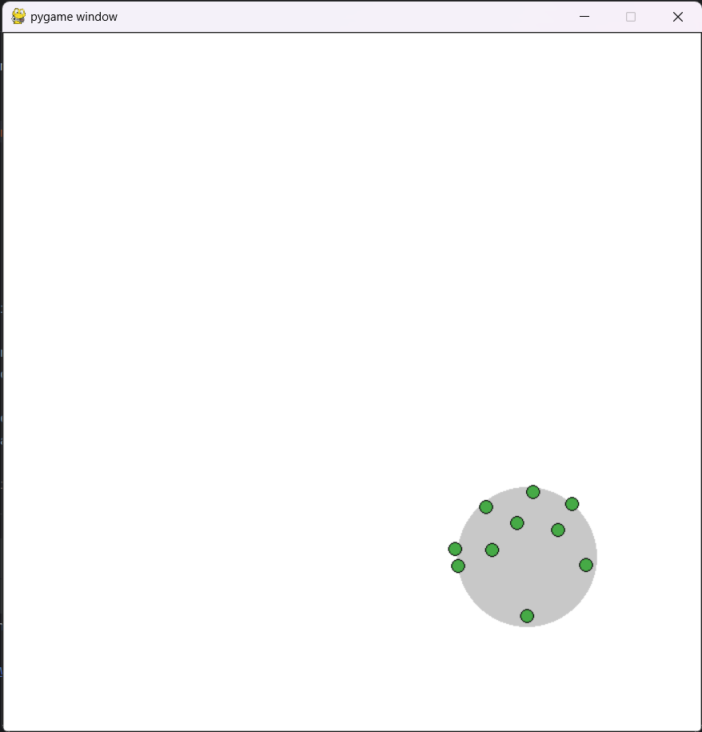

Models and Policies
Models:
Simple: Choose random action, repeat while reward increases, then choose again
ANN: Multilayer perceptron (MLP), Proximal Policy Optimization (PPO)
Simple
ANN

Slide 7
Rewards
Negative if outside play area
Zero if in play area but outside shape
If inside shape, the distance to the closest other agent (spread out)

Slide 8
Evaluation
By looking at the training graphs, we can gain information about the difficulty of the task, and how efficiently the algorithm learned. Was the zero rewarding a problem?
To see the performance of the networks, we can look at the results visually.

Slide 9
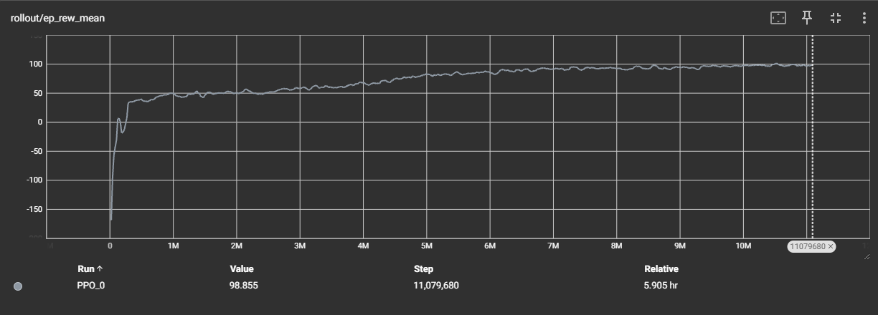
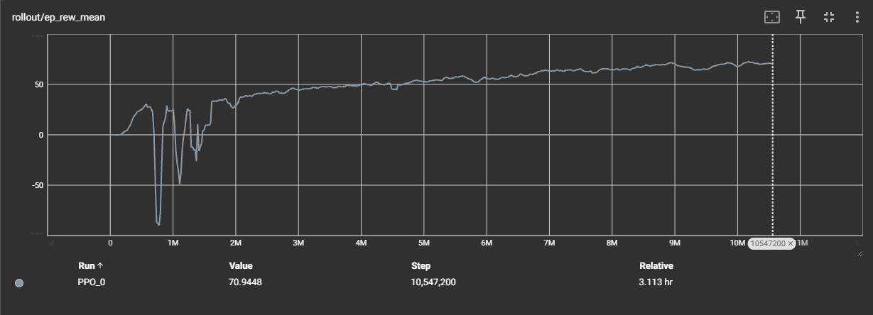
Reward mean during training
Circle
Mountains

Slide 10
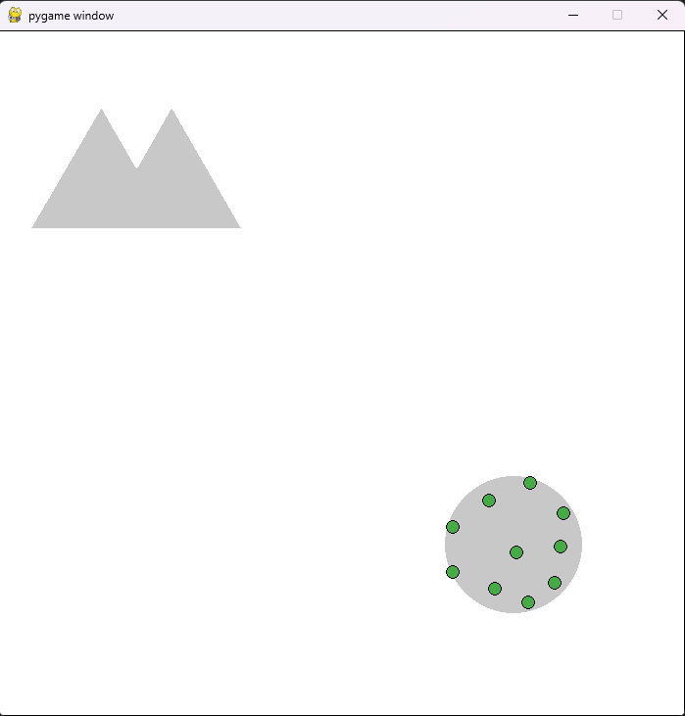
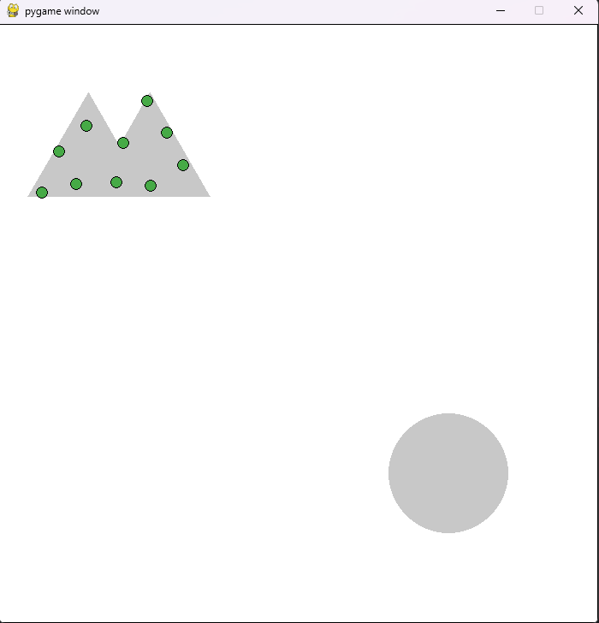
Results
Circle
Mountains

Slide 11
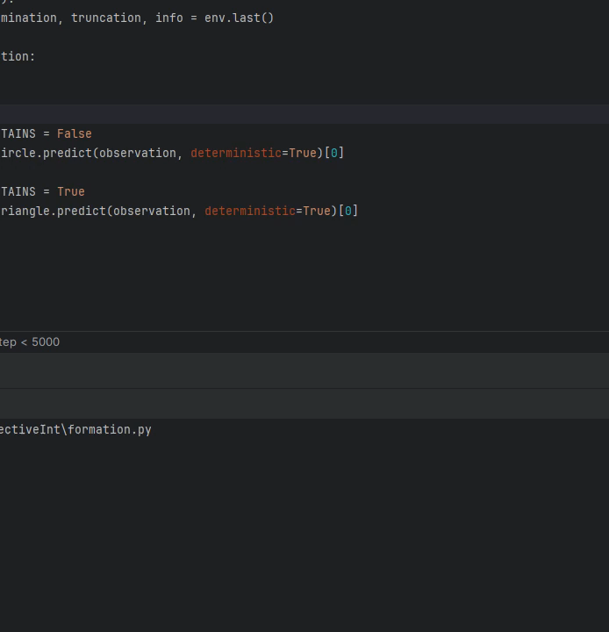
Results

Slide 12
Conclusion and Further Work Example
Conclusion
Simplifying the observation space for the specific task is necessary.
Reward function is generalizable to many shapes.
Training to move from one shape to another is easier than from random position.
Further Work
Find the limitations of the reward function.
Find a way to eliminate oscillations.

Slide 13
Thank You for Your attention!
Questions?
Ákos Rúzsa fr2wt6@inf.elte.hu

